Slide 1
Serving Undocumented Adult ESL Learners in a Changing World
Christian English Language Teachers (CELT) Conference
Pittsburgh, PA – March 22, 2022
Dr. Janet Eyring
Emerita Professor of TESOL
California State University, Fullerton
jeyring@fullerton.edu

Slide 2
Introduction: Teaching Background
Retired Professor from CSU Fullerton
43 years in the TESOL field
Co-writer of multi-level ESOL “Gospel Literacy” series for non-literate and semi-literate members of the Church of Jesus Christ of Latter-day Saints
Currently serving as an education missionary for my church, teaching online ESOL class, English Connect 3, to South American members
Taught or observed teachers in many non-credit adult ESL settings: adult schools, community college continuing education programs, community centers, community-based organizations, libraries, churches, and prisons

Slide 3
Motivation for this study
My passion: adult non-credit ESOL
Roll sheets do not distinguish documented from undocumented.
Students rarely admit they crossed the border illegally or overstayed a visitor visa.
Large influx of migrants has stimulated much debate and also apprehension among citizens.
Covid crisis has made it more difficult for the undocumented to continue ESOL studies: strain on family, job changes, children home from school, healthcare concerns, etc.
Illegal status makes the undocumented more vulnerable to scams, discrimination, and crime.
What can we do as ESOL professionals to support these students in a legal, proactive way?

Slide 4
Organization of Presentation
Who are the undocumented?
Why have they come to the U.S.?
How well are they being served by public/ private institutions or organizations?
How has U.S. immigration policy affected the undocumented?
How has political debate affected views on illegal immigration?
How can teachers become better advocates?

Slide 5
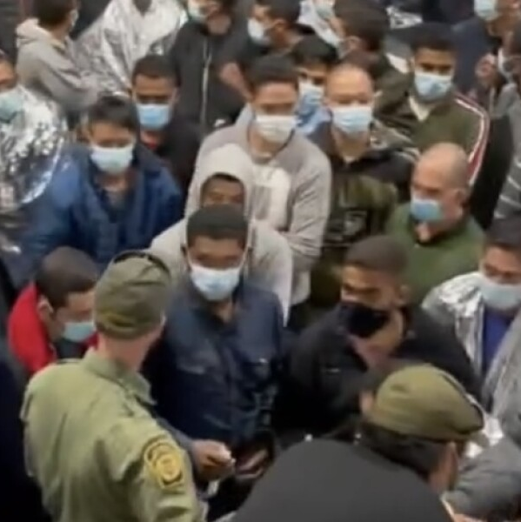
I. Who are the undocumented?
In 2019 there were 11,000,000 (Migration Policy Institute, 2021) (about the size of New York City and Houston)
A fluctuating statistic that varies by those who enter illegally, overstay a visa, voluntarily leave the country, are deported, die, or become lawful residents (Lopez, Passel & Cohn, 2021)
75% from Latin America, 15% from Asia and 10% from other countries (Migration Policy Institute, 2021).
Most come by foot, car, and by truck from Mexico and Central America.
584,885 came from other countries by plane and other means and overstayed their visas in 2020 (Homeland Security, 2021).

Slide 6
Who are the undocumented?
Mexican and Central American immigrants remain less educated than immigrants of other nationalities--e.g., from Asia (Passel & Cohn,2019).
85% have lived here from 10-to 20 years or more (Migration Policy Institute, 2021).
50% live in California, Texas, or New York.
20% live in counties around 4 major cities: Los Angeles, New York, Houston and Chicago
SURPRISE! For those who entered unlawfully between 2015 to 2020, there was a pattern of ”little growth or decline” (Capps, R., Gelatt, J., Guiz Soto, A.G., & J. Van Hook, 2020)

Slide 7
Big Change in FY 2021
1,956,519 were encountered by Customs and Border Protection at or between entry points (US Customs and Border Protection, 2022a). This was the highest number in over 20 years (Chiacu, 2021).

Slide 8
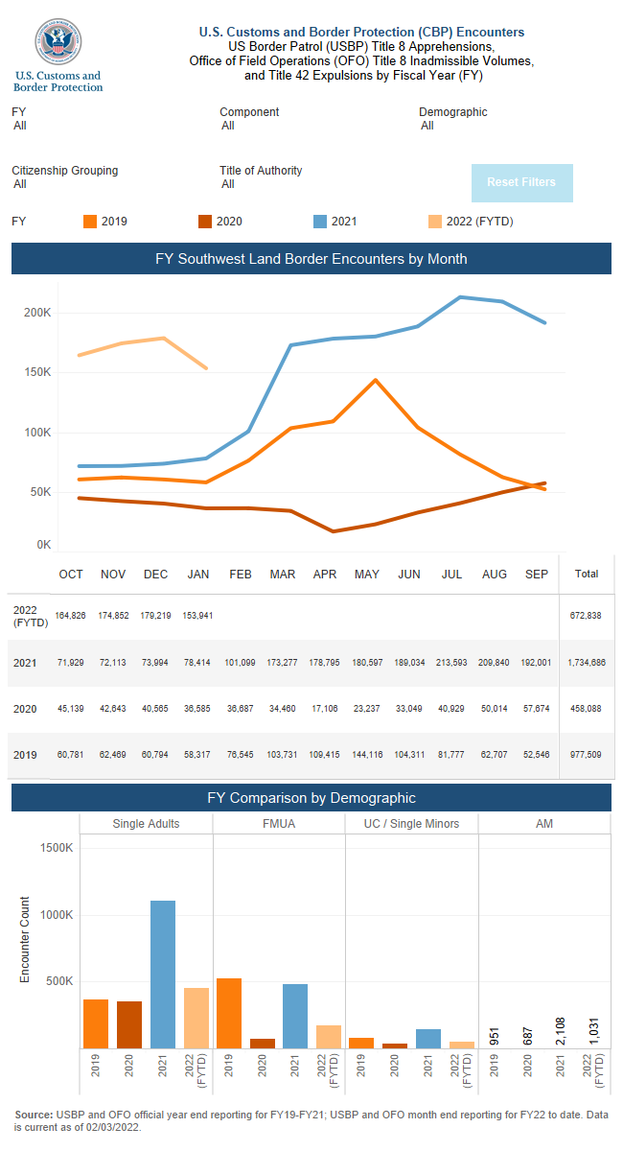

Slide 9
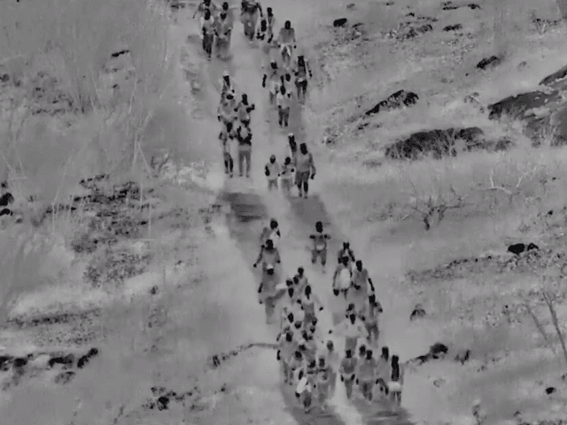
Characteristics of unauthorized immigrants in FY 2021 (U.S. Customs & Border Protection, 2022c; Sullivan and Jordan, 2021)
Sullivan and Jordan, 2021, New York Times
Type of people crossing | Number | Percentage
Unaccompanied children without parents or legal guardians | 146,054 | 8%
Migrant families | 478, 492 | 28%
Single adults (388,249 were women & girls) | 1,098,500 | 64%
TOTAL | 1,723,046 | 100%
*An addition of approximately 500,000 undocumented were “got aways (Murdock, 2022).

Slide 10
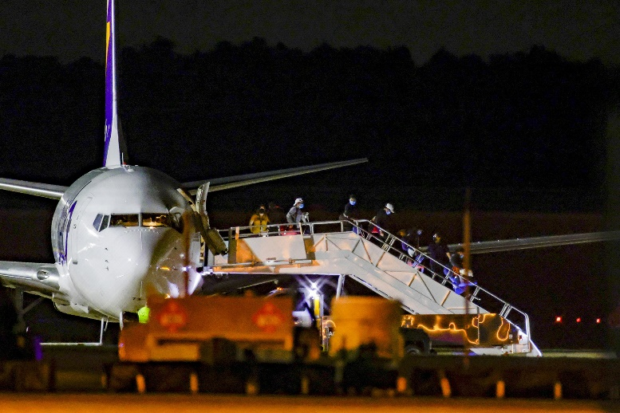
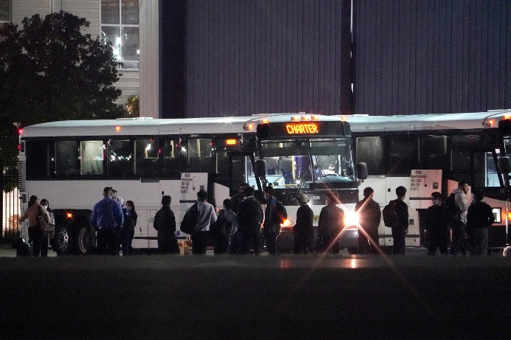
CBP Enforcement Decisions affecting unauthorized immigrants. (Miroff, 2021; Mortensen, 2021; Shaw & Melugin, 2022; Sullivan & Jordan, 2021; U.S. Customs and Border Enforcement, 2021; U.S. Customs and Border Protection, 2022a)
Unauthorized immigrant result/Numbers affected | Number of unauthorized immigrants | Percentage
Were denied admission or withdrew application for admission and returned to native countries. | 294,352 | 15%
Were expelled under Title 42 CDC order of health emergency or Title 8 immigration enforcement cases | 1,720,000 | 62%
Were repeat crossers, detained, or released into the U.S. by CBP, sometimes without covid tests and sometimes with criminal records | 449,999 | 23%
Total CBP Encounters | 1,956,519 | 100%

Slide 11
II. Why have they come to the U.S.?
They are fleeing effects of covid on local economies, unemployment, food insecurity, gang violence, drug cartels, extortion, and environmental problems, e.g., earthquakes, floods, and hurricanes. (Bolter, 2021).
They come for education, health care, more opportunities for children, and the “The American Dream.”
There are huge backlogs on processing visa applications. Immigrants know they will have long waits if they file legal applications. 3,620,240 visa applications awaited processing in 2019 (North, 2020).

Slide 12
II. Why have they come to the U.S.?
Immigrants know they will be rejected if they say they crossed for financial reasons. (Being poor is not a valid reason for asylum).
Survey of undocumented Mexican immigrants showed that, despite trials living in the U.S., they believed they were better off in the U.S. than in Mexico (Pew Research Center, 2009).
Biden’s campaign promise to increase immigration was perceived as an open invitation (Davis, 2021).
More lax enforcement policies than with the Trump administration make it easier to cross the border (Bolter, 2021; Davis, 2021).
United Nations (UN) agencies and non-profit organizations, which the UN funds, provide cash, food, shelter and legal services along the migrant trail, facilitating illegal U.S. border crossings (Bensman, 2022).

Slide 13
II. Why have they come to the U.S.?
Some undocumented immigrants are criminals who blend into the caravans (U.S. Customs and Border Protection, 2022b).
Coyotes, drug cartels, and sex traffickers take opportunities to exploit individuals along the way (Bensman, 2021).
Migrants experience danger and trauma leaving/fleeing their homelands.
This has also led to thousands of deaths of Americans by fentanyl, manufactured in Mexico with ingredients from China, smuggled over an open U.S. border (Bielski, 2021).
Cartels charge $2500 to move people from Mexico to the U.S., $3000 from countries in South America, $5000 from China, and $9,000 from the Middle East and Russia (Jones, as cited in Bensman, 2021).
Human slave labor is sometimes required to pay back sums of money that migrants do not have to cross the border.

Slide 14
III. How well have they been served in public Adult Education?
Adult Education is the “poor step-sister” of K-12 education and Post-secondary education (Larotta, 2017).
ESL/ESOL constitutes the largest segment of Adult Education with others enrolled in Adult Secondary Education (ASE) and Adult Basic Education (ABE).
646,452 out of a total of 1,289,540 students were enrolled in “English Language Acquisition” or ESOL classes between July 1, 2018 to June 30, 2019,
Curricula range from general ESOL, family literacy, civics, and workplace education. Workforce development through federally-funded WIOA programs take precedence (Eyring, 2014).
The funding in 2018-2019 was about $582 million (federal) and $1.375 billion (non-federal). (Compre: federal government spends about 640 billion on K-12 each year.) (National Association of State Directors of Adult Education, 2020).
Adult ESL education is severely underfunded and only serves a small portion of the undocumented.

Slide 15
Private Non-profit 501(c)(3)organizations are picking up the slack
Types of non-profits which may provide ESOL instruction and work preparedness (Hung, 2007):
Church and religious organizations (ex. Catholic Charities)
Cultural heritage organizations (ex. National Association for the Education and Advancement of Cambodian, Laotian, and Vietnamese Americans (NAFEA)
Service agencies (ex. Mexican American Legal Defense and Education (MALDEF))
Immigrant secular organizations (ex. Northwest Immigrant Rights Project)
Non-profits serve approximately 30% foreign-born, of which 33% are undocumented (Hung, 2007; Martin, 2012)
Non-profits may be subsidized by private donors, state funds, philanthropic organizations (e.g., Ford Foundation), corporations (ex., FedEx), or federally supported organizations like IOM (IOM-United Nations Migration, 2022)
Non-profits genuinely want to serve the undocumented because they are the most vulnerable and have the greatest need (Martin, 2012).
Students sometimes feel safer attending classes at private vs. public institutions (Larotta, 2017).

Slide 16
How well have adult ESOL teachers served them? (Eyring, 2014)
Adult ESOL teachers play indispensable roles as community resources and/or advocates for their learners.
Adult ESOL teachers are often part-time and may not be certificated.
Some piece together multiple part-time jobs to make ends meet. (Freeway Flyers in LA)
TESOL has developed Standards for ESL/EFL Teachers of Adults (2008), but implementing these standards is entirely voluntary.
Staff development often includes only voluntary attendance at workshops, conference, or seminars.
There is a high turnover rate of adult ESL teachers as well as a continual need to train new teachers.
WEAK COMBINATION: Overworked part-time teachers (low funding does not provide for full-time teachers with benefits) and immigrants with no legal status.

Slide 17
IV. How has U.S. immigration policy affected the undocumented? (Center for Immigration Studies, 2022)
14th Amendment guarantees birthright citizenship and legal paths to citizenship
The U.S. encouraged relatively open immigration in the 1800s.
In the 1980s and 1990s, Congress passed several pieces of legislation that allowed in more immigrants and amnesty
Since 9/11, the public has been less favorable about immigration (almost 3,000 deaths caused by people on student or tourist visas)
Reform bills in Congress in 2006, 2007, 2013, 2017, and 2018, but none of them passed, often because of lack of public support.
Obama issued an executive order in 2014 which would assist 3.6 million children of undocumented immigrants (DACA program for “Dreamers”)

Slide 18
Trump Immigration Policies (Center for Immigration Studies, 2022; Jenkins, 2018) (continued)
Trump proposed granting legal status to DACA recipients and a pathway to citizenship in exchange for border wall and other security measures. Neither side was in favor.
Signed several executive orders in 2017 signaling “zero tolerance” for illegal immigration.
Made travel ban on visitors from 7 countries because of security concerns.
Banned over 135 million visitors because of covid.
Rescinded Obama’s DAPA order for unauthorized immigrants who are parents of DACA children.
Attempted to phase out DACA, making children of unauthorized immigrants, eligible for deportation. Court order overturned decision.
Started building a wall on the southern border

Slide 19
Biden Immigration Policies (Chishti & Bolter, 2022; Homeland Security, 2021; Krogstead & Gonzalez-Barrera, 2022)
In 2021 Biden replaced Trump’s executive orders with more of his own.
Stopped building the border wall and overturned travel ban.
Changed enforcement guidelines for Immigration and Customs Enforcement (ICE) to limit enforcement to those who 1) pose a national security risk, 2) have been convicted of certain crimes or 3) who recently entered the country illegally.
Ended Trump’s Remain in Mexico policy. Lawsuit forced Biden to reinstate policy.
Requested that Congress pass legislation for a pathway to citizenship for all 11 million unauthorized immigrants in the U.S.
raised the refugee cap to 125,000 for FY 2022.
Notes:
In 2021 Biden rescinded many of Trump’s executive orders with his own executive orders and stopped building the border wall.
He requested that Congress pass legislation providing a pathway to citizenship for 11 million unauthorized immigrants in the U.S.
For FY 2022, he raised the refugee cap to 125,000.
He plans to give particular focus to resettling Central Americans fleeing violence, LGBTQ refugees, Afghans who worked for U.S.-based organizations, at-risk Uyghurs, Hong Kong dissidents and refugees from Burma, including members of the persecuted Rohingya Muslim minority.

Slide 20
V. How has political debate affected views on illegal immigration?
Progressive Conservative
*OPEN BORDERS *REGULATED BORDERS

Slide 21
Border Enforcement Policies and Perspectives
Progressives (Bensman, 2022) | Conservatives (McClay, 2019)
Philosophical Foundation: One World Order with open borders | Philosophical Foundation: US Constitution and Law with regulated borders
Labels for immigrants: unauthorized immigrants, non-citizens | Labels for immigrants: illegal aliens, undocumented immigrants

Slide 22
Border Enforcement Policies and Perspectives
Progressives | Conservatives
Policies and Perspectives: -Fluid borders -Assist the unauthorized -Abolish ICE -Defund the police -Do not detain the unauthorized -Provide amnesty and work permits for all -Use “catch and release” -Stop Remain in Mexico Policy | Policies and Perspectives: -Sovereign borders -Protect the legal immigrant or citizen -Use law enforcement and ICE to deport unauthorized according to law -Accept legal immigrants -Allow immigrants with “credible fear” to plead their case for asylum -Build walls or surveillance to protect citizens -Use Remain in Mexico Policy

Slide 23
VI. How can teachers become better advocates for the undocumented student?

Slide 24
ADVOCACY: What can you do in your own classroom? (Crawford & Witherspoon Arnold, 2016; Miles, 2021; Nash, 2019); Schmidt, 2020)
1.Provide a warm and welcoming climate.
2.Be aware of psychological health of learners, including culture shock.
3.Genuinely compliment and encourage all learners.
4.Become better prepared to address the ESOL learning needs of immigrant learners.
5.Make assignments which allow students to share their concerns.

Slide 25
ADVOCACY: What can you do in your own classroom? (Finn Miller, 2019; Larrotta, 2017; Miles, 2021; Nash, 2019; Vanek, Wrigley, Jacobson, & Isserlis 2020)
6.Solicit input on class study topics.
7.Build a stimulating and interactive learning community.
8.Argue for adequate resources, staff, materials appropriate to ESL.
9.Use home language (if you know it) to help explain information to immigrants and help them navigate a new society.
10.Collaborate with others to provide information about the community.

Slide 26
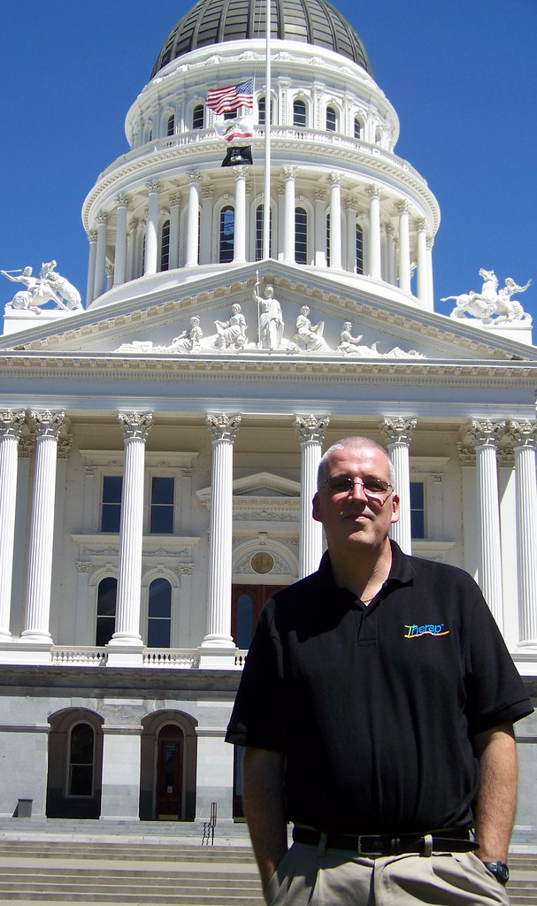
ADVOCACY: What can you do outside your classroom? (Finn Miller, 2019; Larotta, 2019; Mortrude, 2020; Taylor, 2016)
1. Join and become more active in professional organizations that advocate for immigrants.
2. Become better informed about immigrant issues.
3. Follow legislation affecting immigrants.
4. Testify to congressional committees.
5. Write texts and letters to politicians.
This Photo by Unknown Author is licensed under CC BY

Slide 27
ADVOCACY: What can you do outside your classroom?
6. Write blogs and letters to the editor informing others about pertinent topics.
7. Post information and engage in conversation on social media about immigrant issues and current legislation.
8. Participate in rallies, demonstrations, and town halls that include teachers, but also politicians, and students.
9. Register to vote…and don’t forget to VOTE!
This Photo by Unknown Author is licensed under CC BY

Slide 28
Join professional organizations which advocate for adult ESOL education
American Association of Adult Continuing Education (AAACE) https://www.aaace.org/
Coalition on Adult Basic Education (COABE) - https://coabe.org/
National Association of State Directors of Adult Education - http://nasdae.org/ (NASDAE)
Proliteracy - https://www.proliteracy.org/
Teaching English to Speakers of Other Languages (TESOL) - https://www.tesol.org/
TESOL Affiliates such as CATESOL, Intermountain TESOL, Illinois TESOL, Sunshine State TESOL, etc. - https://www.tesol.org/connect/tesol-affiliate-network/worldwide-affiliate-directory/worldwide-affiliate-directory----u-s-affiliates

Slide 29
TESOL Advocacy Action Center https://www.tesol.org/advance-the-field/advocacy-resources

Slide 30
TESOL Position Statement on Immigration Policy and Reform in the United States
TESOL supports carefully considered and comprehensive immigration reform proposals in the U.S, that “offer orderly and fair pathways to legal residency and citizenship for all immigrants.”

Slide 31
COABE Legislative Center – Easy way to TAKE ACTION and write your own letters to your legislators. https://coabe.org/legislative-center/

Slide 32
COABE Ambassador’s Program to train teachers and students to tell stories of immigrant contributions and successes that will persuade legislators.

Slide 33
Conclusion
Since 2021, more undocumented immigrants have been entering the U.S. than in the past 20 years. The number of undocumented in Adult ESOL fluctuates and is not well researched.
Immigrants enter the U.S. illegally for a range of reasons—fleeing traumatic situations in their native countries to overstaying a visa.
Millions of undocumented adult immigrants live in the U.S. but public and private programs are not adequately funded to address their English and work-related needs.
The U.S. legislature has not successfully implemented comprehensive immigration reform, which both addresses the economic and social well-being of the nation and the civil and human rights of immigrants.
Teachers can become better advocates of the undocumented by teaching English well, making content relevant, building a class community, and becoming more involved politically on immigrant issues.

Slide 34
Questions for Discussion
1.What grade (A+, B, D-, etc.) would you give yourself or the ESOL profession for adapting to the needs of adult learners during the pandemic? Why?
2.Here are some statements about the undocumented. Why are they false choices?
1. If you care for the poor and needy, you must be in favor of open borders.
2. If you believe in law and order, you must think all DACA recipients should be deported.
3. If you are in favor of comprehensive immigration reform, you are against building a border wall.
4. If you believe in equality of opportunity, you should accept visa overstays.
5. If you believe in restricted immigration, you are anti-immigrant.
3.What insights and lessons does the Bible provide for balancing respect for law and compassion for undocumented immigrants?

Slide 35
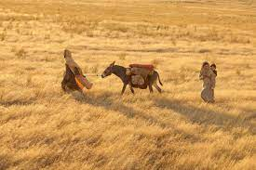
Old and New Testament Examples of People Migrating (Wright, 2018)
Exodus of Abraham and his people migrating from Ur to Canaan because of God’s call (Exodus 12:1-3)
Jacob and his sons leaving Canaan and going to Egypt to escape famine (Genesis 46)
Jews being exiled to Babylon because of losing the war against Nebuchadnezzar (2 Kings 24:10-16)
Mary and Joseph fleeing to Egypt to escape Herod’s killing of firstborn sons (Matthew 2:13-23)
Various stories of early Christians being scattered because of religious persecution (Acts 8:1-4; 1 Peter 2:11-12; James 1:1)

Slide 36
Illegal Immigration and the Church of Jesus Christ of Latter-day Saints
According to Wright (2018), Campbell, Karpowitz & Monson in the Faith Matters Survey (2011) showed American LDS “are more accepting of immigrants than most other Americans.”
Official statement of the Church of Jesus Christ of Latter-day Saints (2011):
”Most Americans agree that the federal government of the United States should secure its borders and sharply reduce or eliminate the flow of undocumented immigrants.”
“Unchecked and unregulated, such a flow may destabilize society and ultimately become unsustainable.”
“The Church of Jesus Christ of Latter-day Saints discourages its members from entering any country without legal documentation, and from deliberately overstaying legal travel visas.”
In recent years, the LDS Church has favored more “open” and “inclusive” immigration policies, including compassion towards “Dreamers.”
The Church has also taken a vocal stand for moderate immigration reforms that balance a law-and-order mentality against compassion for immigrants and a strong desire for policies that keep families together (Wright, 2018).

